Slide 1



MULTIMODAL RAG-BASED
PRODUCT RECOMMENDATION SYSTEM
Hazal KANTAR
Ahmet Doğukan GÜNDEMİR
Ali Boran BEKTAŞ
Hikmet Berkin BULUT
Advisor: Assist. Prof. Dr. Serdar ARSLAN
1

Slide 2
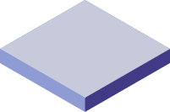
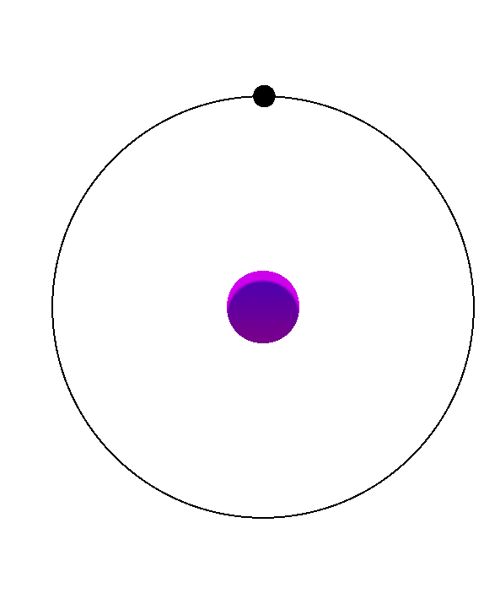
CONTENTS
PROBLEM
WORK PLAN
ANALYSIS
SOLUTION
RESULTS AND CONCLUSION
PROOF OF CONCEPT
REFERENCES
2

Slide 3
Problem
Individuals often struggle to choose outfits or cosmetics that match their needs and preferences, while the fashion and cosmetic industries face challenges in delivering user-personalized, trend-aware recommendations.
3

Slide 4
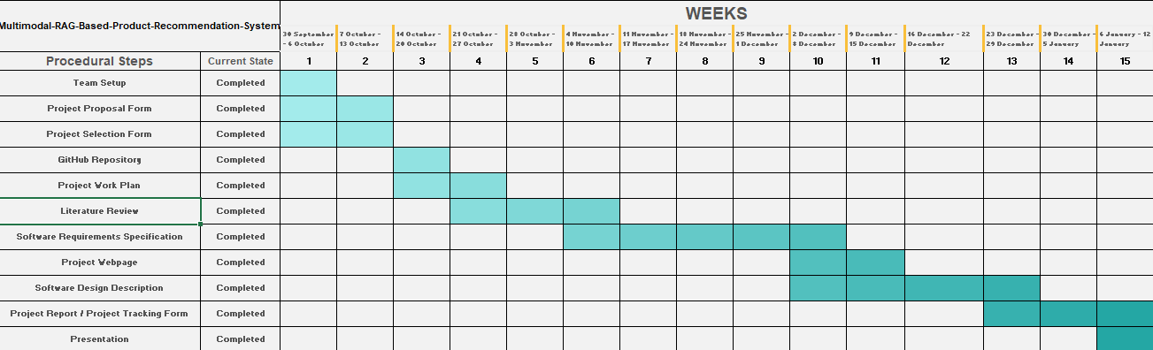
Work Plan
4

Slide 5







Analysis
What is a RAG System?
How Does Multimodal Work?
Image + Text Pairs
Multimodal RAG Architecture
Detailed Steps in Multimodal RAG
Used Models (CLIP, LlaMa 3, Gemini, GPT-4)
Deployment Challenges and Solutions
Top Papers (MuRAG)
Similar Systems (Intelistyle, The Iconic; Perfect Corp, Formulate)
Our
Project
Cosmetic Recommendation
Fashion Recommendation
5
Personalized Fashion & Cosmetic Recommendation
Chatbot

Slide 6
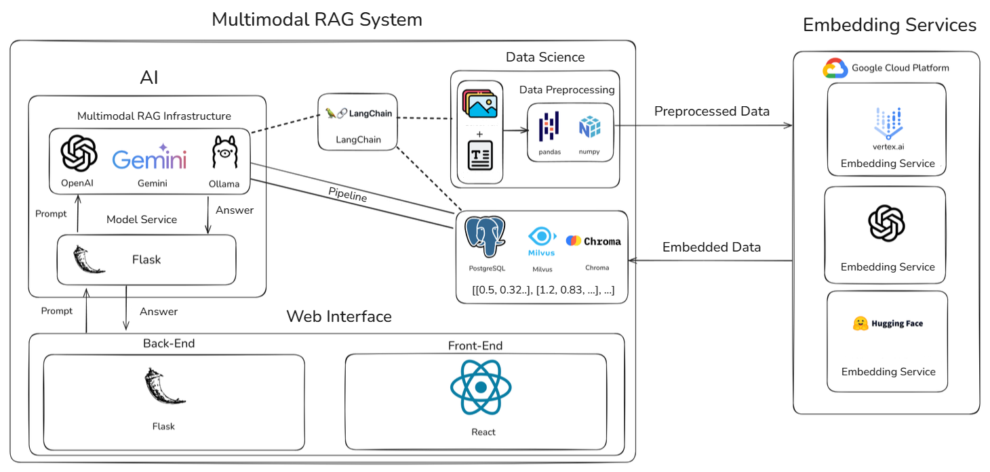
Solution
Multimodal RAG System Chatbot
User Friendly Chatbot
Personalized Recommendations
User-Friendly Interface
Sustainability Integration
Trend Analysis
Image and Text Processing
OpenCLIP for Embeddings
Real-Time Updates
AI-Driven Insights
6

Slide 7
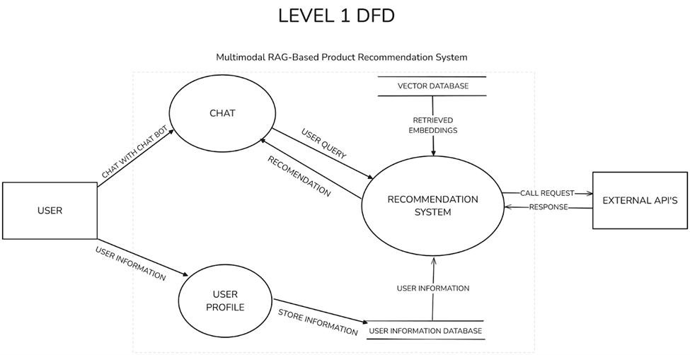
Solution
Data Flow Diagram
7

Slide 8
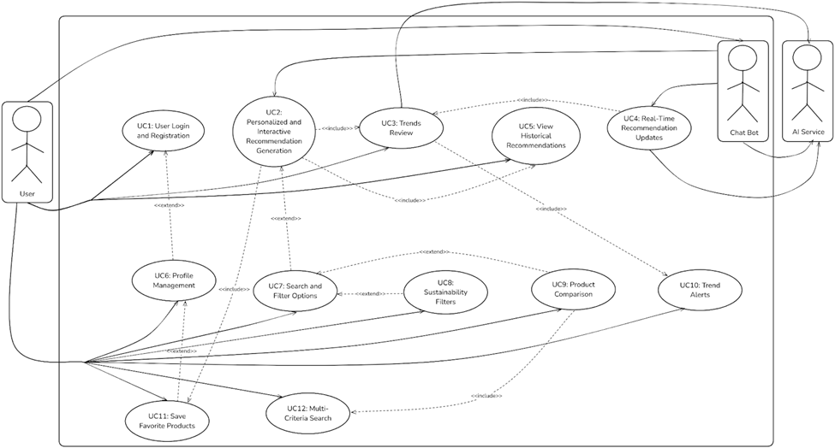
Solution
Use Case Diagram
8

Slide 9

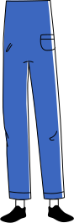
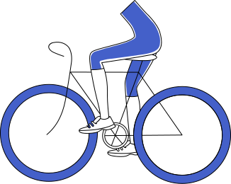

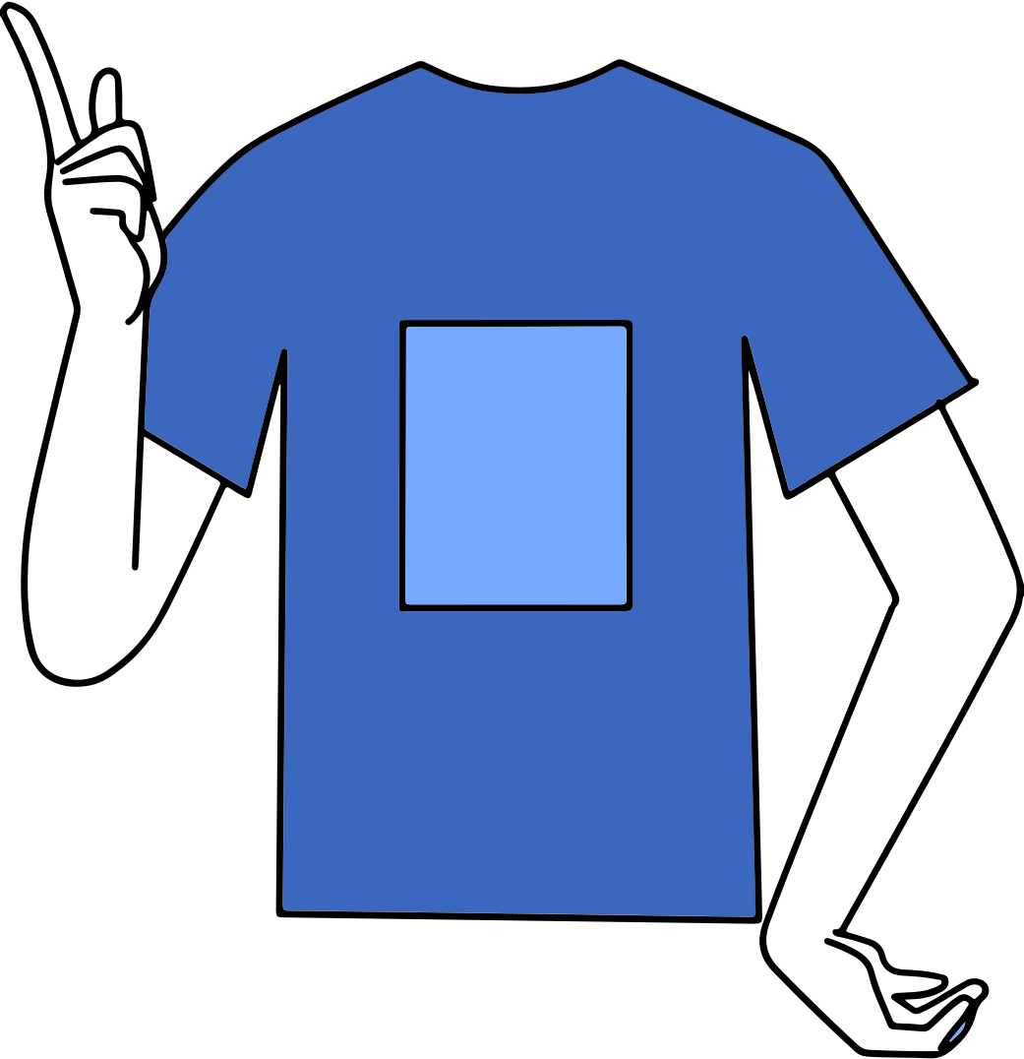

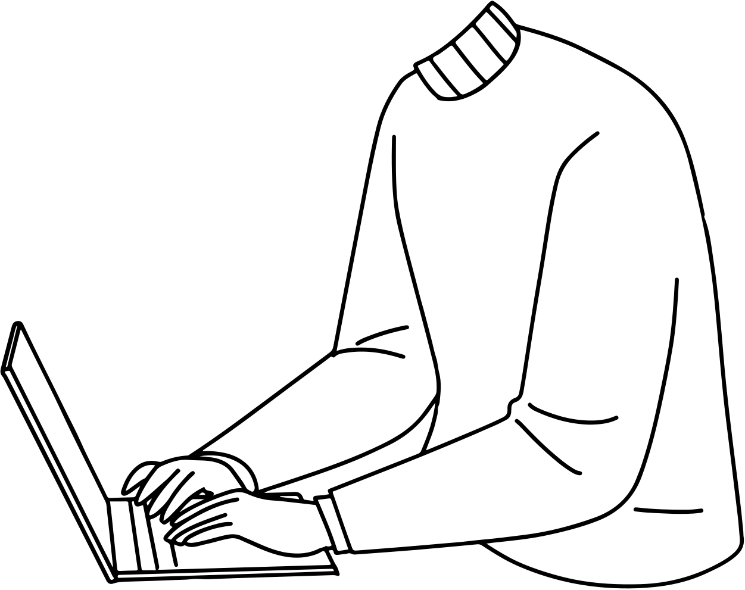



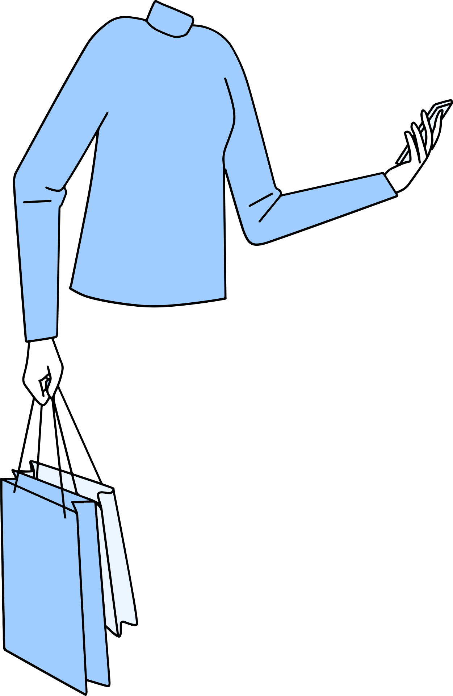
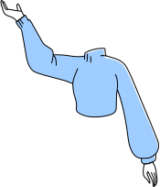
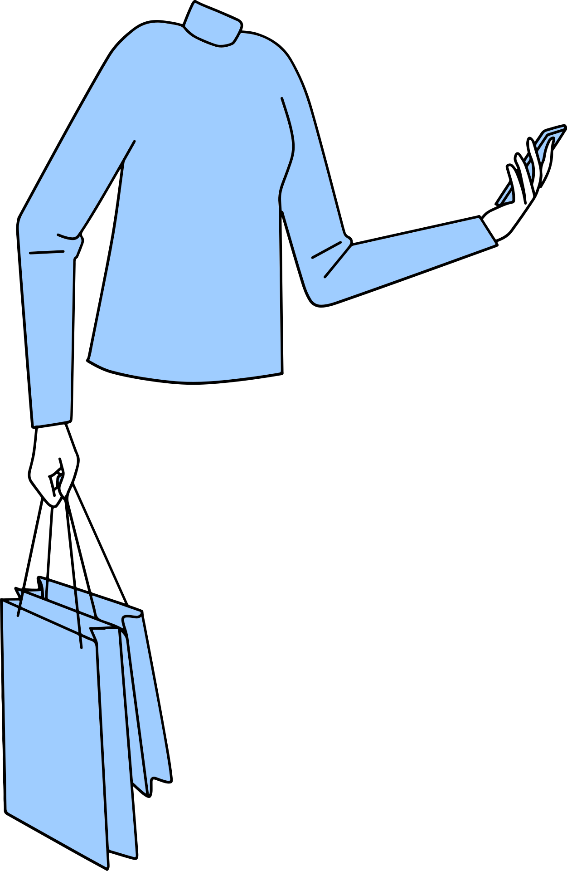

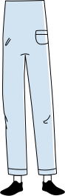
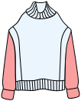
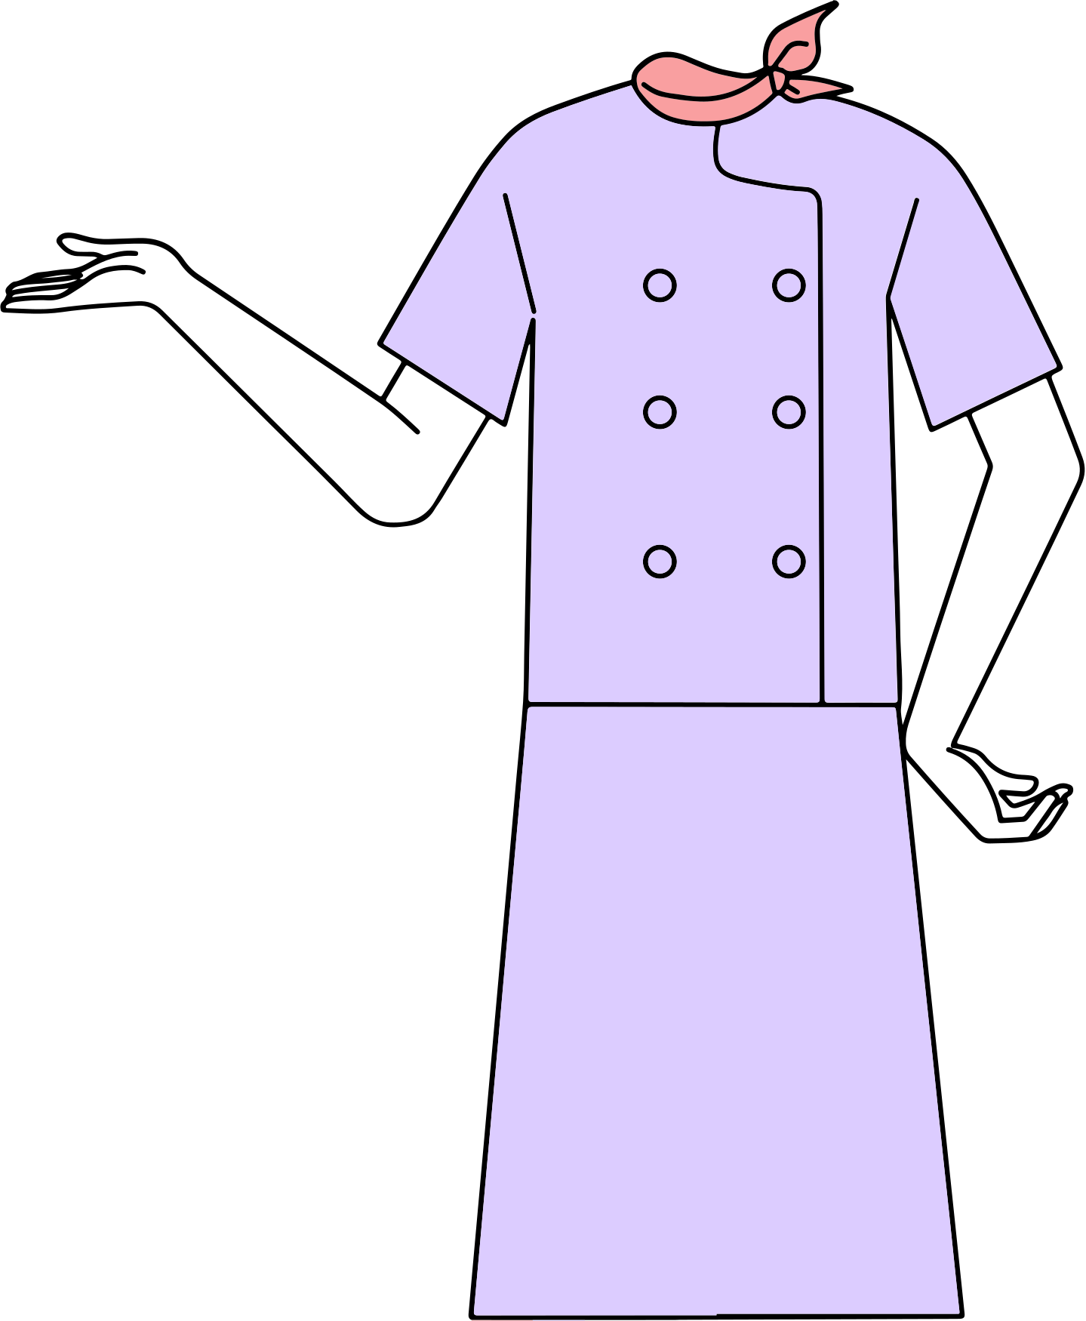
Storyboard
1
2
3
Solution
The user shows interest in buying clothes and wants to explore his options.
The user spends a lot of time browsing the internet and various platforms to find the product he is searching for.
The user decides to physically visit a store for shopping, which takes too much time. He may not even find what he is looking for after all this time.
3
1
2
Another user needs new clothing and knows her interests, want to explore options.
The user starts browsing clothing options on our application. User looks at recommended items, imagining some outfit options with the assistance of a digital AI assistant.
The user interacts with the application and communicates with the chatbot to quickly find the desired product and complete the purchase quickly. The user found the exact outfit match for her preference in little time.
9

Slide 10
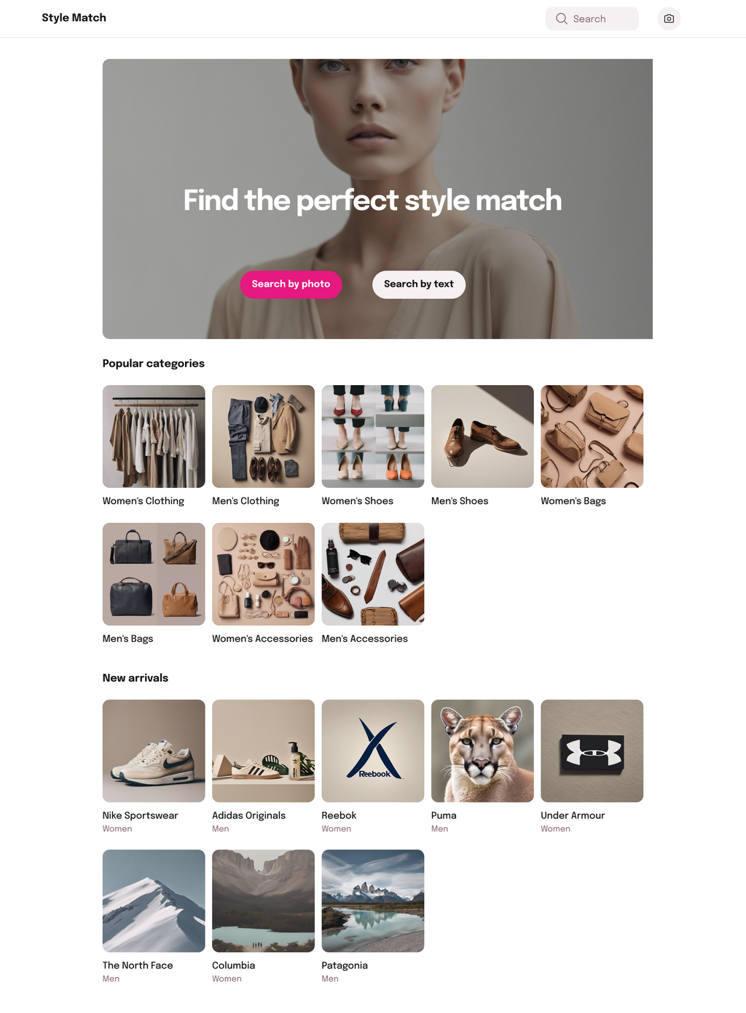
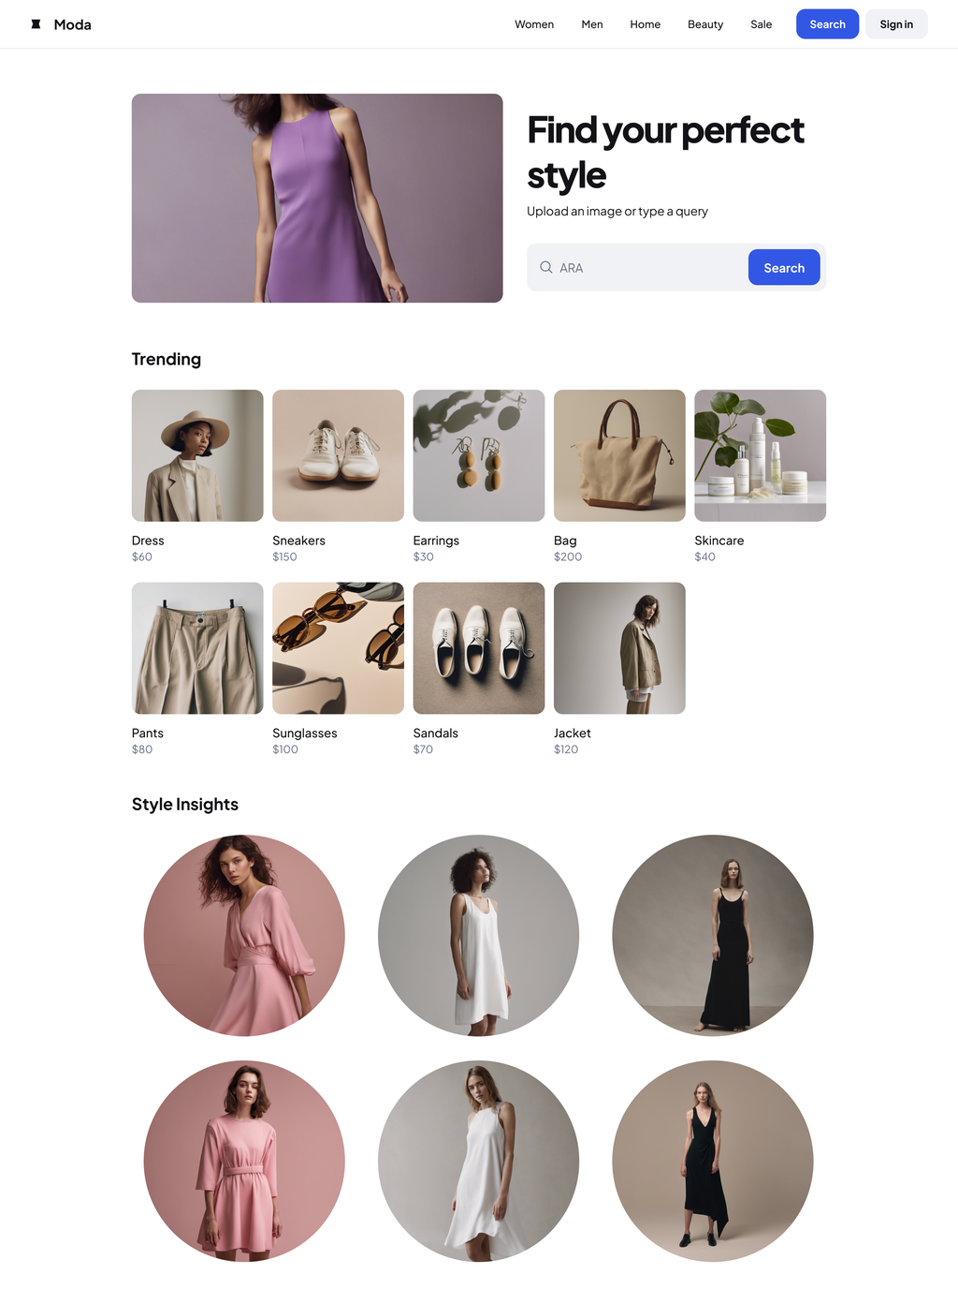
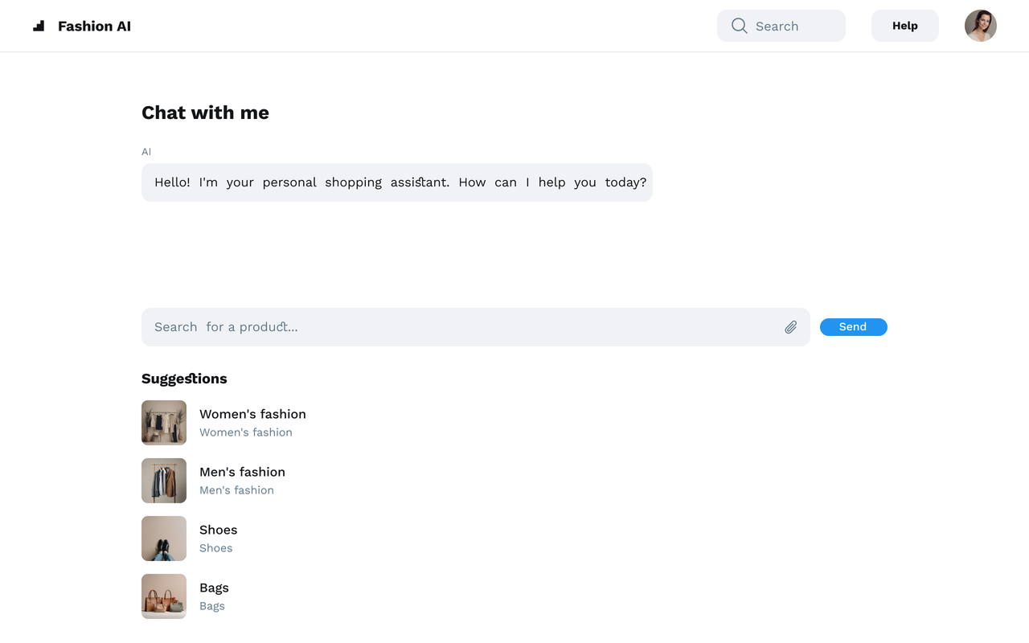
USER INTERFACE DESIGN
Chatbot Interface :
Text and Image input/output
Personalized recommendations
Main Page Interface:
Search or Initiate chat
Categories
Search by text/image
Trending Page Interface:
Search products by text/image
Trends review
Style insights
10

Slide 11
Results and Conclusion
Documentation: Comprehensive LR, SRS, and SDD documents.
Multimodal AI Focus: Seamless text and image processing.
Personalized Recommendations: User-specific insights with RAG.
Trend Awareness: Trend insights to align with the current market.
Sustainability Integration: Includes eco-friendly fashion options.
Enhanced User Experience: Interactive chatbot and dynamic search filters.
Efficient Shopping: Traditional shopping inefficiencies solved.
Future-Ready Design: Emerging AI integrations and scalability.
Retail Sector Innovation: Broader AI adoption in retail.
Innovative AI-driven platform.
11

Slide 12
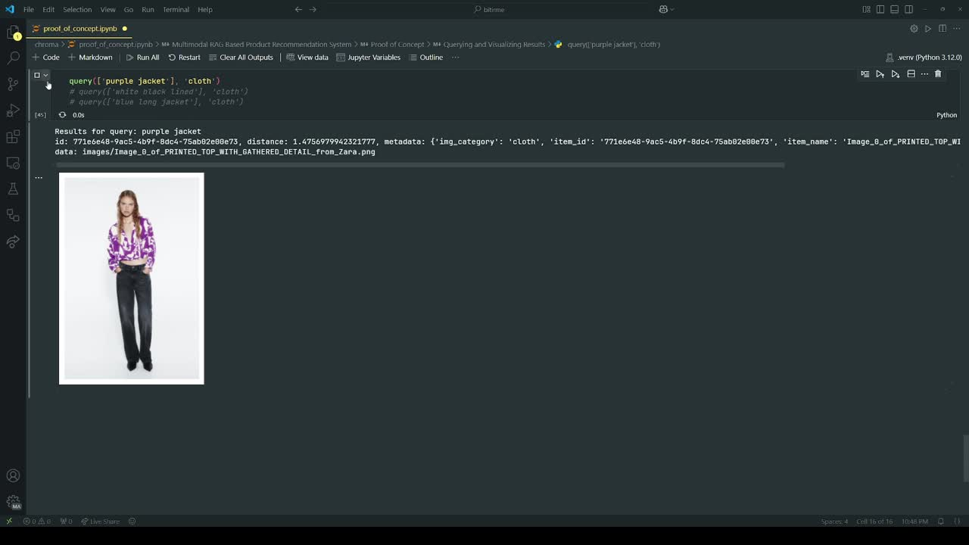

Slide 13
References
[1] Intelistyle. "Fashion Personalisation: The Ultimate Guide." Intelistyle, https://www.intelistyle.com/fashion-personalisation-the-ultimate-guide/. Accessed 08 Nov 2024.
[2] PerfectCorp. "Top 10 AI-Powered Cosmetic Websites and Online Stores." PerfectCorp Blog, https://www.perfectcorp.com/business/blog/makeup/top-10-aipowered-cosmetic-websites-and-online-stores/. Accessed 08 Nov 2024.
[3] Chong, I. (2022). "AI-Powered Personalised Beauty Brands: Investing in AI and AR for Growth." Cosmetics Design Asia, https://www.cosmeticsdesign-asia.com/Article/2022/09/08/ai-powered-personalised-beauty-brands-investingin-ai-and-ar-are-growing-in-double-digits/. Accessed 08 Nov 2024.
[4] New York Post. "Formulate Personalized Shampoo Hair Care Review." New York Post, https://nypost.com/article/formulate-personalized-shampoo-hair-care-review/?utm_source=chatgpt.com/. Accessed 08 Nov 2024.
[5] Chen, W., Hu, H., Chen, X., Verga, P., & Cohen, W. W. (2022). "MuRAG: Multimodal Retrieval-Augmented Generator for Open Question Answering over Images and Text." arXiv, https://arxiv.org/abs/2210.02928.
[6] NVIDIA Developer. "An Easy Introduction to Multimodal Retrieval-Augmented Generation." NVIDIA Developer Blog, https://developer.nvidia.com/blog/an-easy-introduction-to-multimodal-retrieval-augmented-generation/. Accessed 11 Nov 2024.
13

Slide 14


THANK YOU! QUESTIONS?
GitHub Website
14

